Slide 1

SWINGS COMPONENTS AND EVENT HANDLING

Slide 2

SWING API:-
2
2
Swing API is a set of extensible GUI Components to ease the developer's life to create JAVA based Front End/GUI Applications.
It is build on top of AWT API and acts as a replacement of AWT API, since it has almost every control corresponding to AWT controls.
Swing component follows a Model-View-Controller architecture to fulfill the following criteria:
A single API is to be sufficient to support multiple look and feel.
API is to be model driven so that the highest level API is not required to have data.

Slide 3
MVC Architecture:-
3
3
Swing API architecture follows loosely based MVC architecture in the following manner.
Model represents component's data.
View represents visual presentation of the
component's data.
Controller acts as an interface between model and view.
Swing component has Model as a separate element.
The View and Controller part are clubbed in the User Interface elements.
Because of which, Swing has a pluggable look-and-feel architecture.

Slide 4
Swing Features:-
4
4
Light Weight − Swing components are independent of native Operating System's API as Swing API controls are rendered mostly using pure JAVA code instead of underlying operating system calls.
Rich Controls − Swing provides a rich set of advanced controls like Tree, TabbedPane, slider, colorpicker, and table controls.
Highly Customizable − Swing controls can be customized in a very easy way as visual apperance is independent of internal representation.
Pluggable look-and-feel − SWING based GUI Application look and feel can be changed at run-time, based on available values.

Slide 5
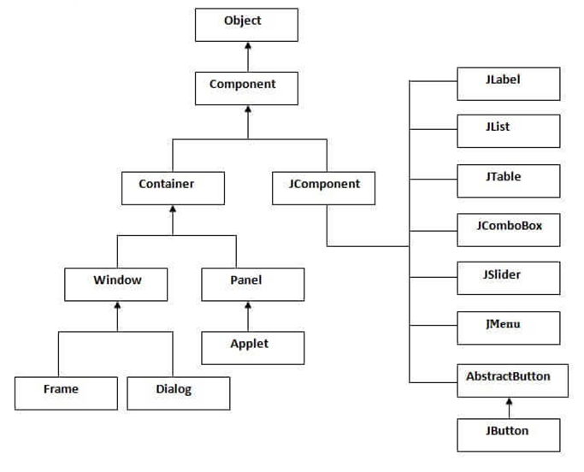
Java AWT, SWING, and Applet Component Hierarchy
5

Slide 6
Java Layout Managers
java.awt.BorderLayout
java.awt.FlowLayout(by default)
java.awt.GridLayout
java.awt.CardLayout
java.awt.GridBagLayout
javax.swing.BoxLayout
javax.swing.GroupLayout
javax.swing.ScrollPaneLayout

Slide 7
7
AWT
SWING
VS
A collection of GUI components and other related and services required for GUI programming in Java.
Components are heavyweight.
Platform dependent.
Does not support a pluggable look and feel.
Has less advanced components.
Execution is slower.
Does not support MVC pattern.
Components require more memory space.
Programmer has to import javax.awt package to develop an AWT-based GUI.
A part of Java Foundation Classes (JFC) that is used to create Java-based Front end GUI applications.
Components are lightweight.
Platform independent.
Supports a pluggable look and feel.
Has more advanced components.
Execution is faster.
Supports MVC pattern.
Components do not require much memory space.
Programmer has to import javax.swing package to write a Swing application.

Slide 8
Event Handling Example:-
8
8

Slide 9
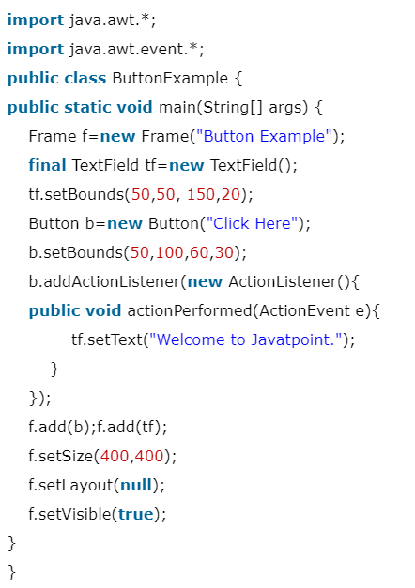
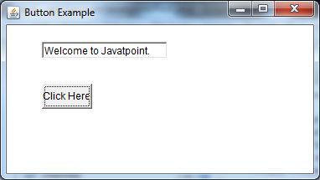
Java AWT Button Example with ActionListener:
9
Output of Java AWT Button Example with ActionListener

Slide 10
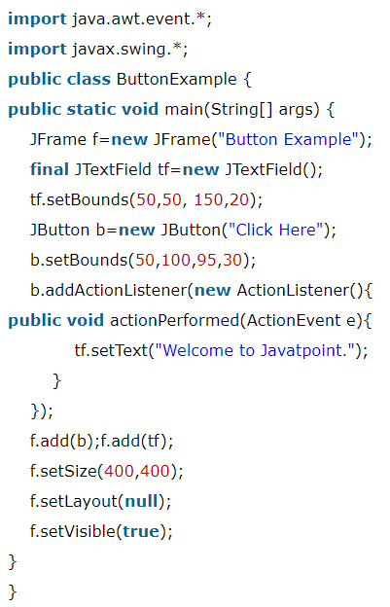
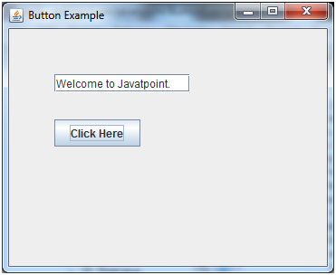
Java SWING Button Example with ActionListener:
10
Output of Java swing Button Example with ActionListener

Slide 11
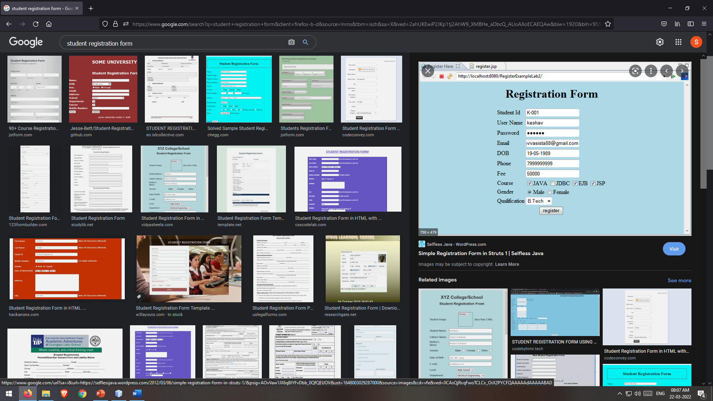
Homework

Slide 12


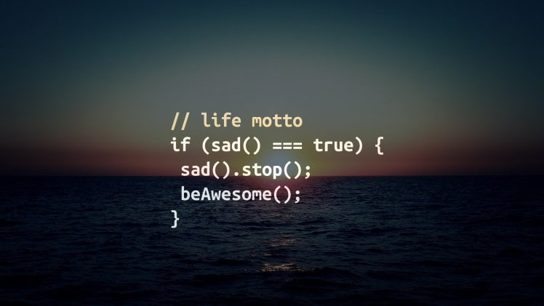
Thank-You!

